Slide 1
DevOps Training Assignment 2
Create EC2 instances
Create one Windows Instance in Public Subnet and connect.
Create one Linux Instance in Public Subnet and connect.
Create one Linux Instance in Private Subnet and connect.
Provide screenshots for everything.

Slide 2
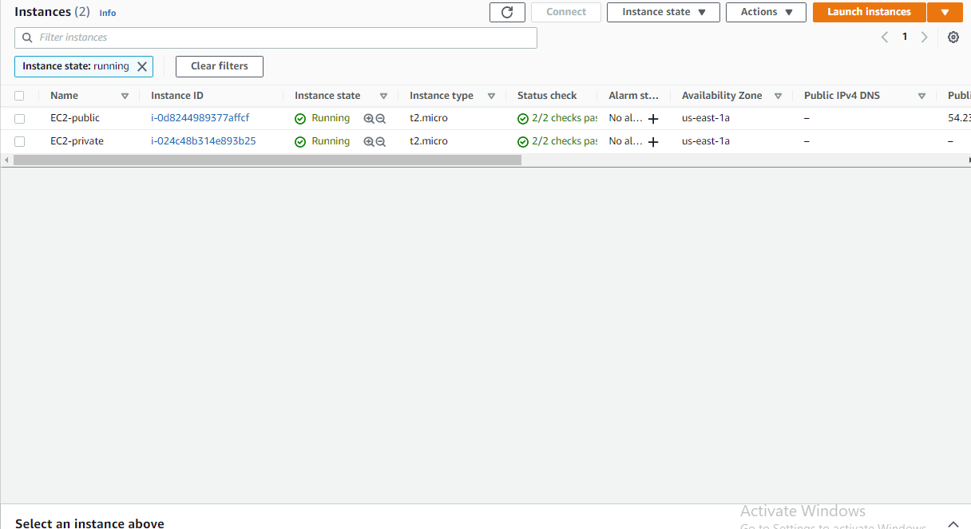
EC2 PUBLIC & PRIVATE - 1

Slide 3
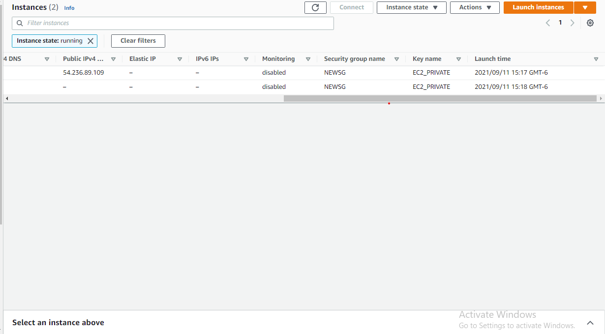
EC2 PUBLIC & PRIVATE - 2

Slide 4
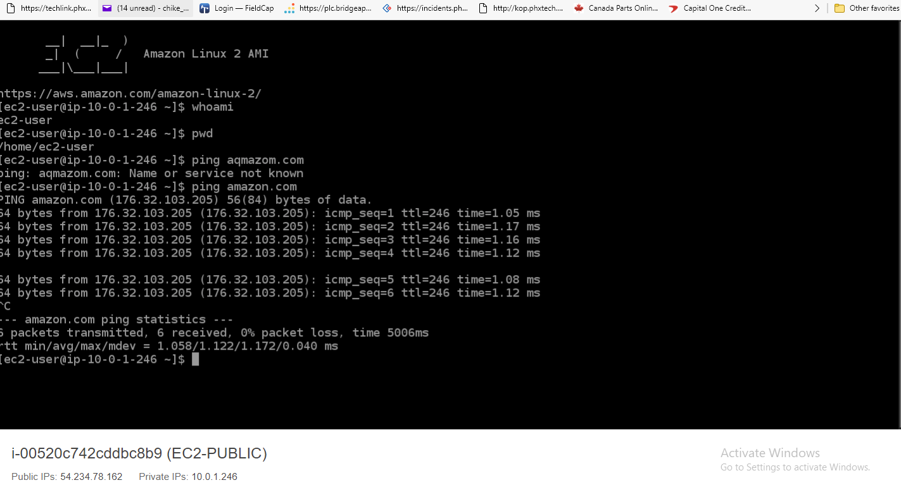
EC2Public – INTERNET_CONNECT

Slide 5
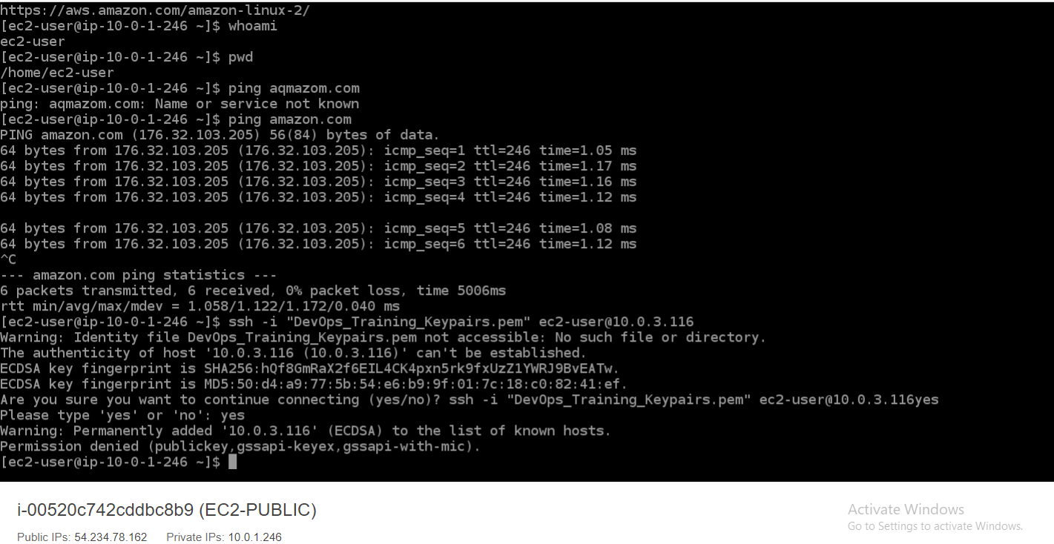
Public – Private JumpServer - NOSUCCESS

Slide 6
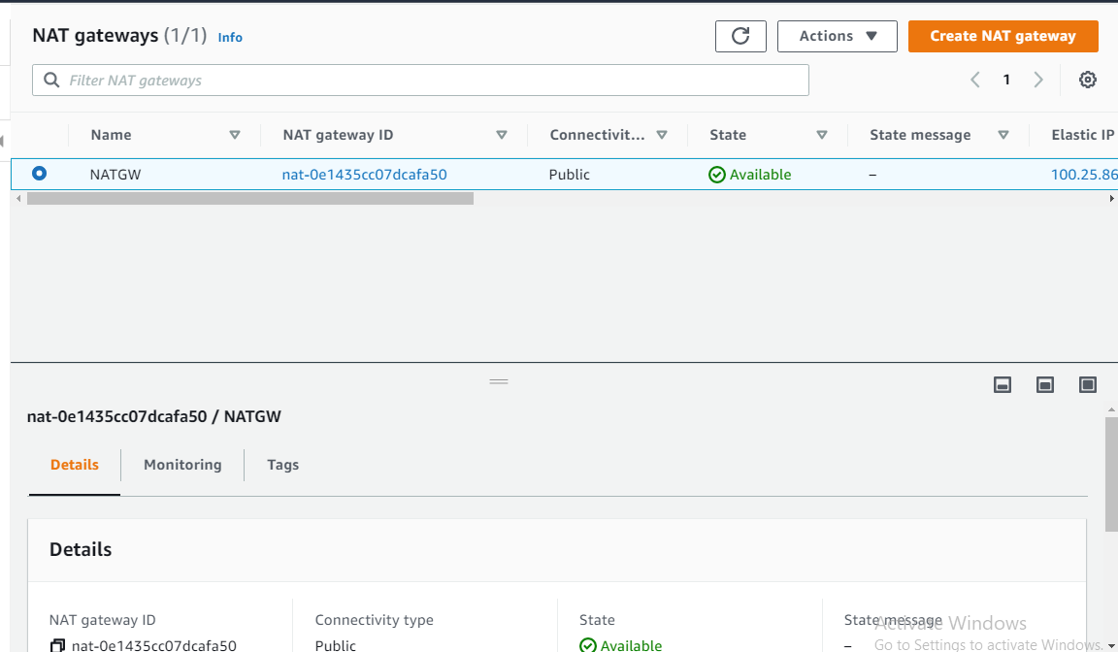
NAT GATEWAY

Slide 7
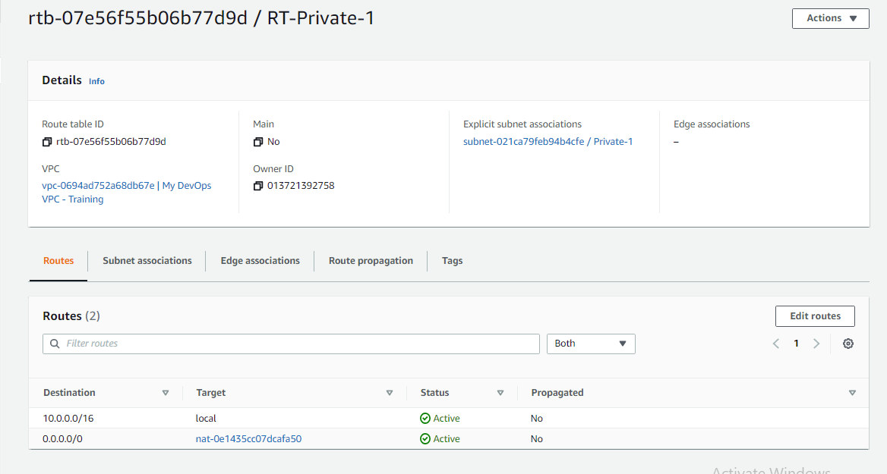
Route Table Edit

Slide 8
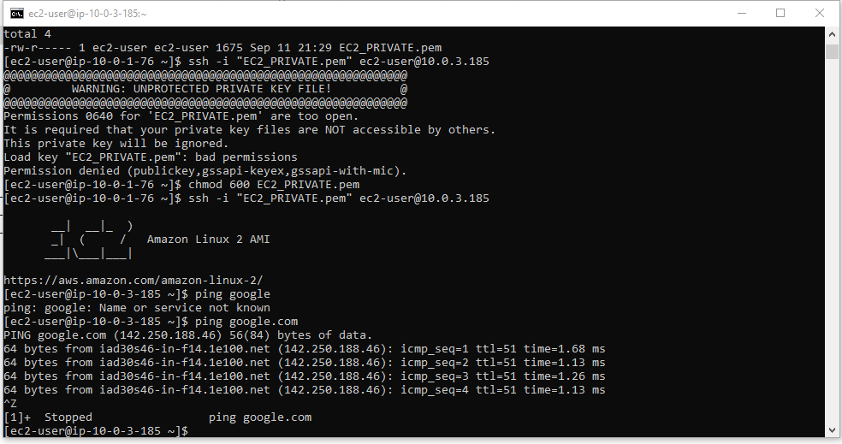
Public – Private JumpServer - SUCCESS

Slide 9
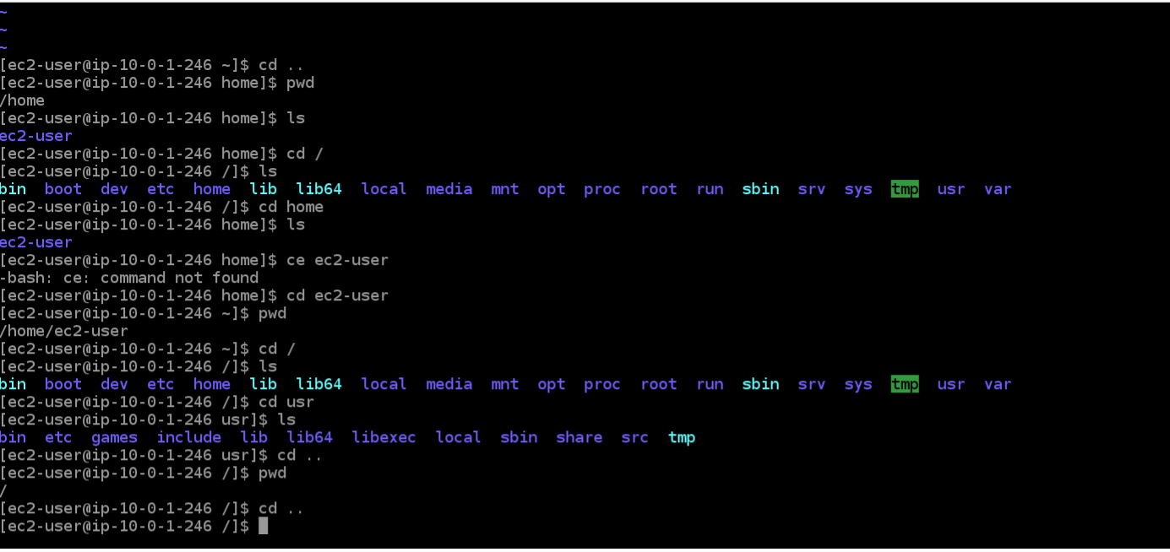
Linus Command – Train1

Slide 10
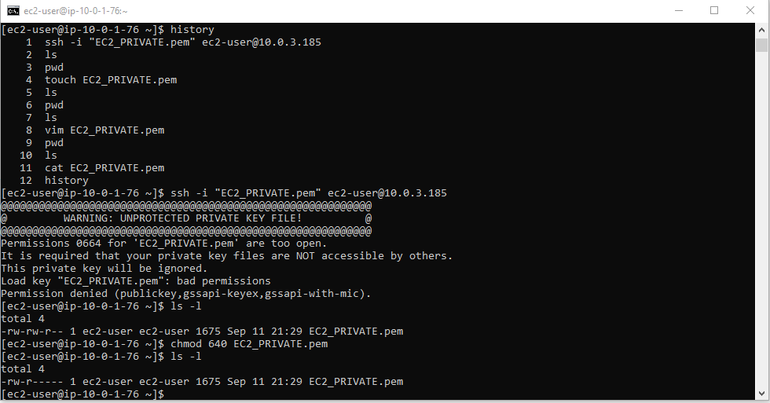
Linus Command – Train2

Slide 11
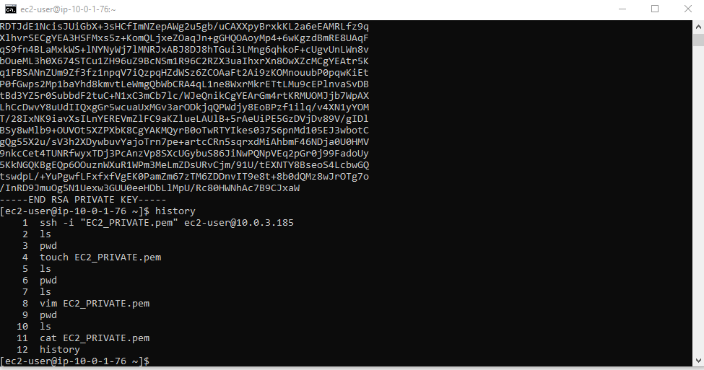
History

Slide 12
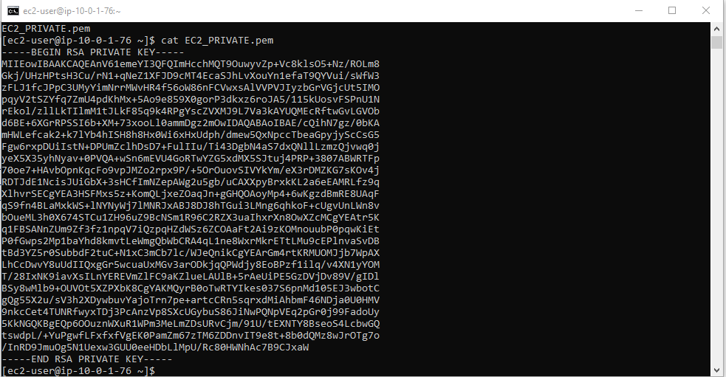
Cat command on *.pem key pair file

Slide 13
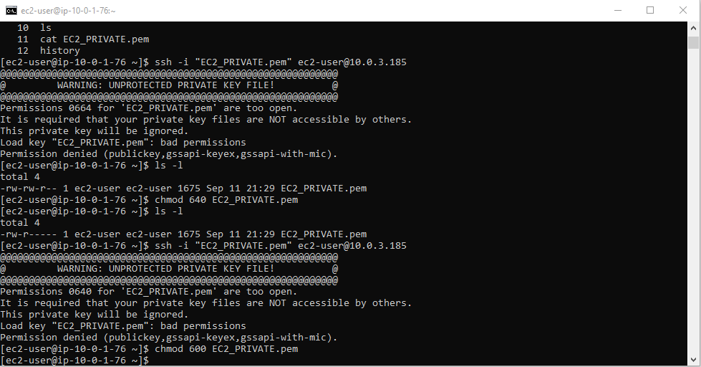
Chmod on *.PEM FILE

